Slide 1

SOFTWARE DESIGN
AND ARCHITECTURE
(SDA)
SESSION 2
UTM KUALA LUMPUR

Slide 2
01
INTRODUCTION
Intro to UML.
02
BEHAVIORAL MODEL
Use Case Diagram, Sequence Diagram, Activity Diagram and etc..
03
STRUCTURE MODEL
Component Diagram, Class Diagram

Slide 3
Unified Modeling Language
Why?
To help to communicate efficiently.
SECURITY PROOF
LANGUAGE
COMPLETENESS
Always get documented then verify and validate with stakeholders.
Different language proficiency.
Clear and concise process to address all requirements.
3

Slide 4
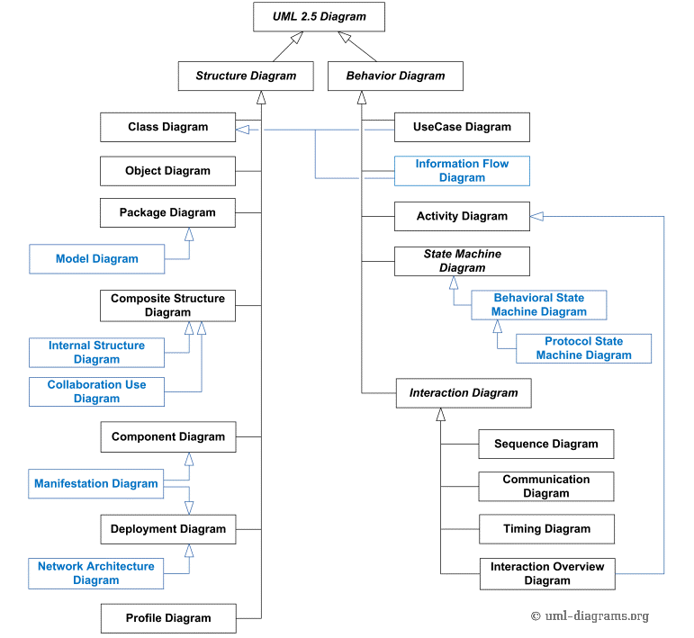
Unified Modeling Language
References
https://www.uml-diagrams.org/
4

Slide 5
BEHAVIORAL MODEL (USE CASE DIAGRAM)
Use case diagram
  Behavioral diagram used to capture, specify, and visualize required system behavior.
    Required system behavior are just requirements!
  The main elements of use case diagrams are actors, use cases, and the relationships connecting them together.
Use cases are entities used in use case diagrams to specify the required behavior of a system.
  They provide the means to capture, model, and visualize the systems’ required behavior.
  They do this without any knowledge of programming technology, so that different stakeholders with different backgrounds can reason about the system. Common UML relationships applied in use case diagrams
5

Slide 6
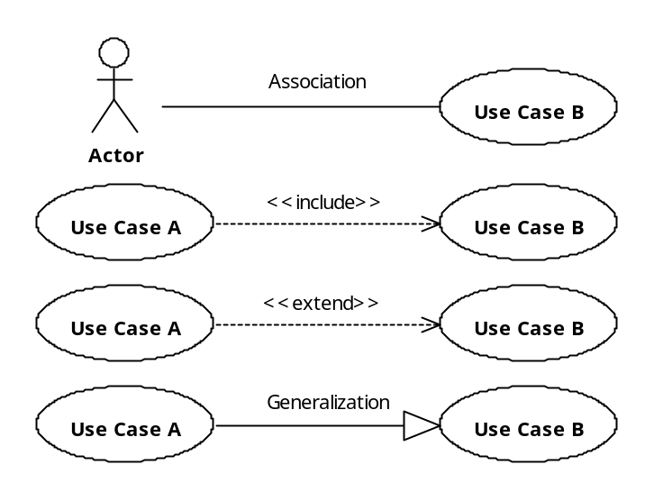
BEHAVIORAL MODEL (USE CASE DIAGRAM)
Common UML relationships applied in use case diagrams.
Actor and use case communicate, for example, actor executes use case.
Named actor
Use case B MUST be executed when use case A is executed!
Use case A requires the behavior from use case B
Use case A extends the behavior of use case B. Use case B may be executed when use case A is executed, but it is not mandatory.
Use case A is a specialization of use case B
Important:
include relationship specifies a mandatory inclusion
Extend relationship specifies an optional inclusion
6

Slide 7
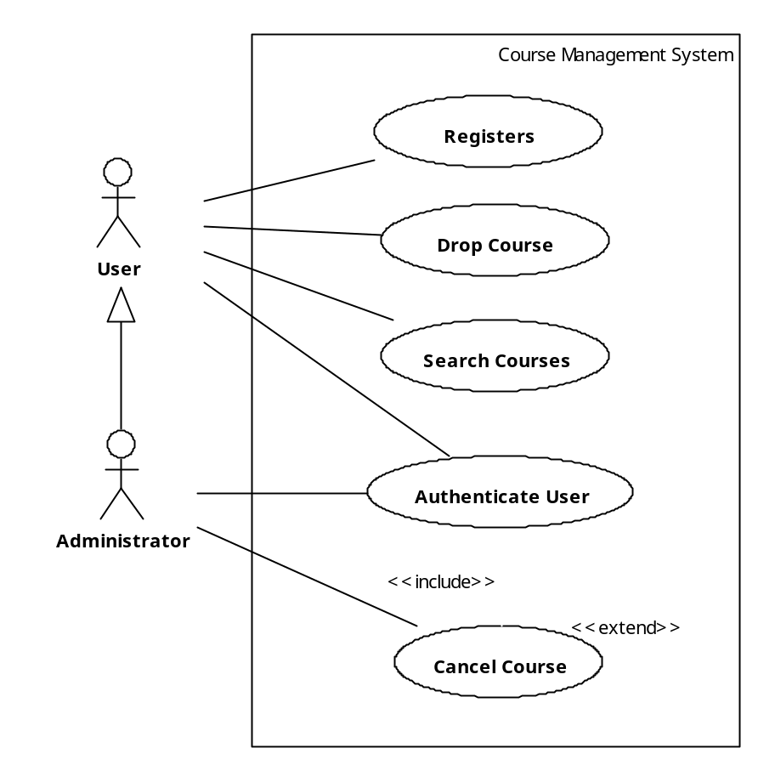
BEHAVIORAL MODEL (USE CASE DIAGRAM)
Optional System Boundary to model the Subject
Actor interacts with the system.
To cancel a course, you may want to search for the course
A specialized user
Alternatively, you may want to enter the course number directly without searching for it.
You cannot cancel a course unless your identity has been authenticated!
7

Slide 8
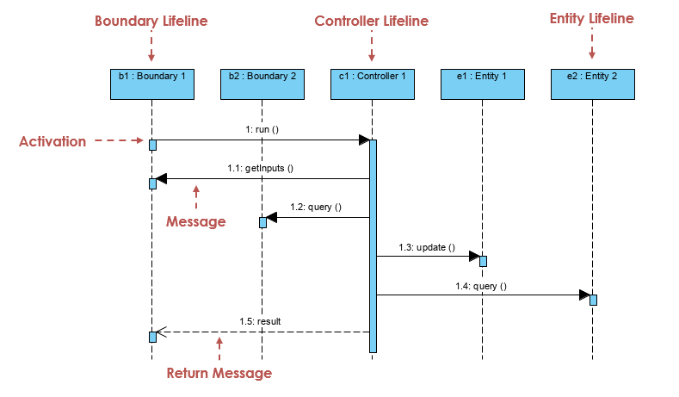
BEHAVIORAL MODEL (SEQUENCE DIAGRAM)
8

Slide 9
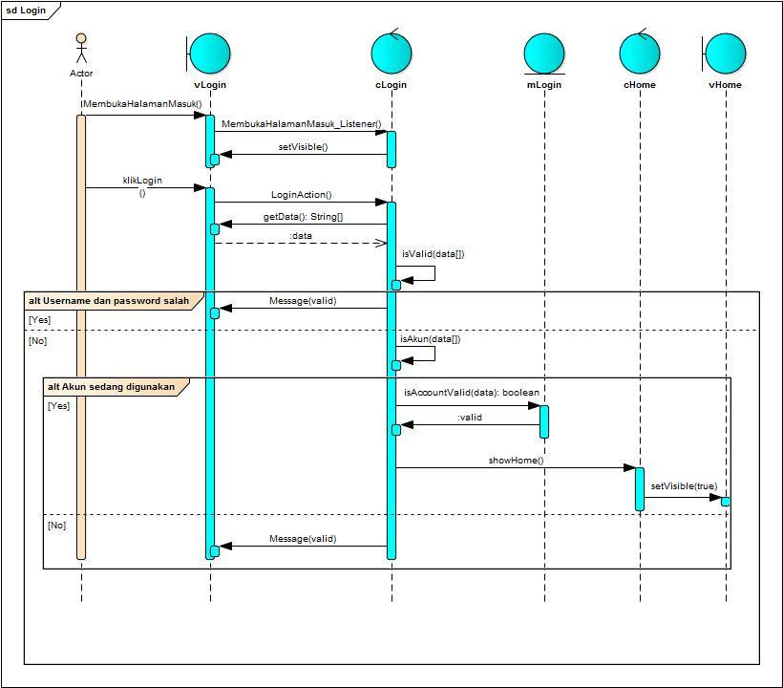
BEHAVIORAL MODEL (SEQUENCE DIAGRAM)
9

Slide 10
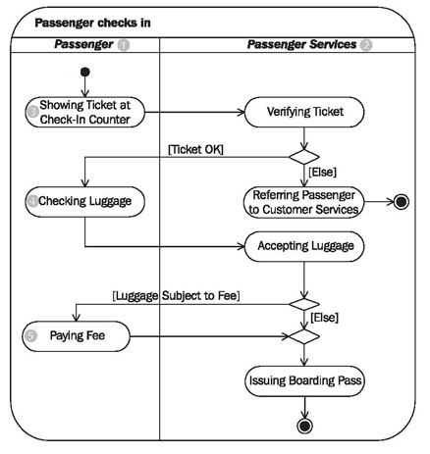
BEHAVIORAL MODEL (ACTIVITY vs STATE)
Showing ticket
Unverified, refer to CS
VERIFYING
Ticket Counter / Page
Check in luggage
CHECKING
Luggage Counter / Page
Luggage Fee
Free, get pass
PAYING
Fee Counter / Page
Paid, get pass
ISSUING
Boarding Counter / Page
10

Slide 11
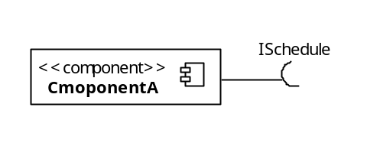
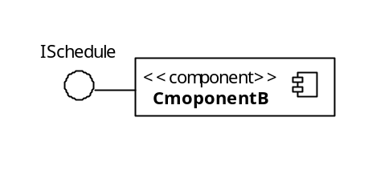
STRUCTURE MODEL (COMPONENT DIAGRAM)
A component represents a modular part of a system that encapsulates its contents and whose manifestation is replaceable within its environment.
Component diagrams are used to model software as group of components connected to each other through well-defined interfaces. They help decompose systems and represent their structural architecture from a logical perspective.
Components can be modeled using an external black-box or internal white-box approach.
  Black-box approach hides the component’s internal structure.
    Components interact with each other only through identified interfaces.
  White-box approach shows the component’s internal structure (e.g., realizing classifiers).
Component interfaces are classified as provided or required interfaces.
  Required interfaces are those the components need to carry out their functions.
  Provided interfaces are used by other external components to interact with the component providing the services.
Let’s formally see how the UML relationships defined in previous sessions apply to the component classifier…
Black-box
Approach
I need a schedule to operate!
I provide a schedule
11

Slide 12
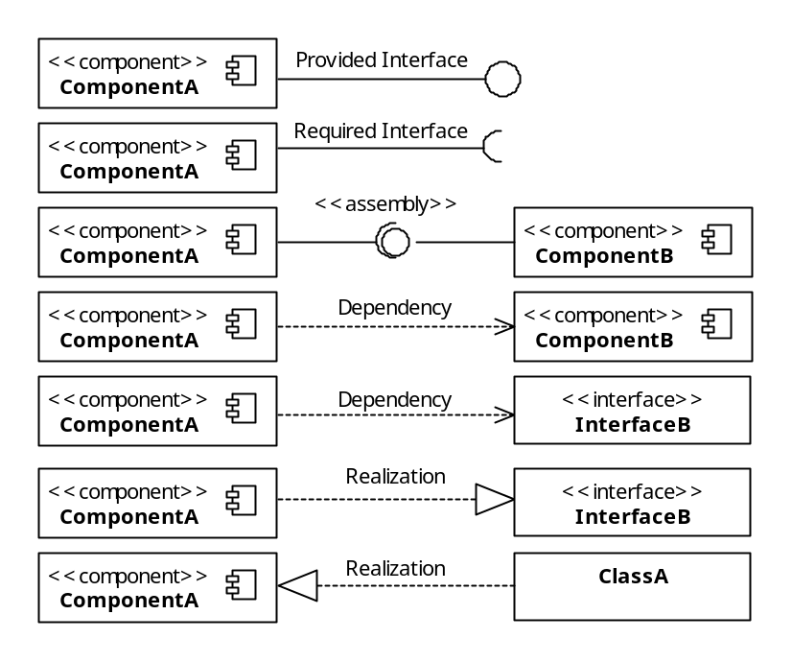
STRUCTURE MODEL (COMPONENT DIAGRAM)
UML relationships applied to the component classifier.
UML Dependency
Dependency without specifying interfaces!
Dependency between required and provided interfaces is equivalent to the assembly connector.
These are equivalent!
Notice these
are interfaces
Notice this is a class
ComponentA
InterfaceB
ComponentA
InterfaceB
12

Slide 13
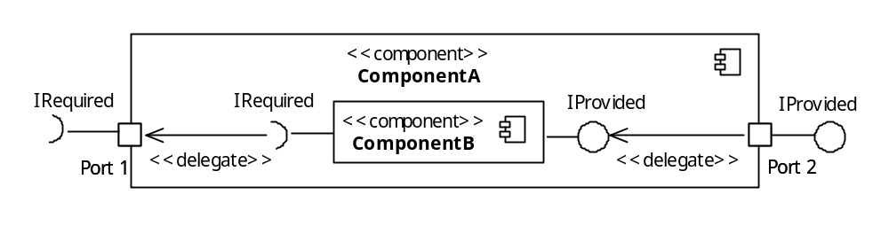
STRUCTURE MODEL (COMPONENT DIAGRAM)
Two more important concepts used in component diagrams are:
  Ports
    Abstraction used to model access points for allowing the external environment to access the component’s services and for allowing components to interact with their external environment.
    Modeled using a small square at the boundary of a classifier, in this case, a component.
    Ports can be named, e.g., port names below are Port 1 and Port 2.
  Delegation connectors
    Used to model the link between the external provided interfaces of a component to the realization of those interfaces internally within the component.
    Similarly, delegation connectors model the link between internally required interfaces to ports requiring the interface from external components.
    Modeled using a directed arrow with the stereotype <<delegate>>
White-box view of ComponentA shows how the external behavior is realized internally
Black-box view of ComponentB
Port
Delegate connector
Port
13

Slide 14
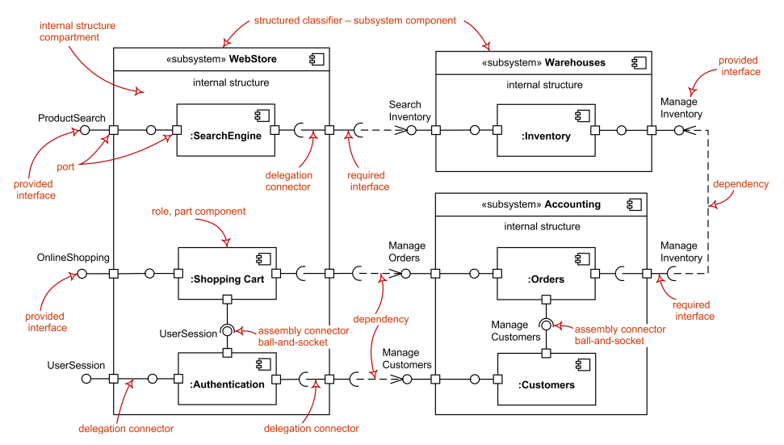
STRUCTURE MODEL (COMPONENT DIAGRAM)
14

Slide 15
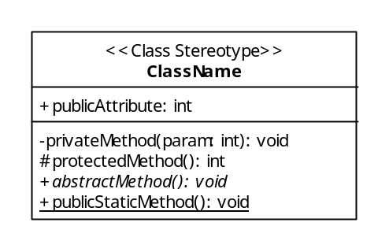
STRUCTURE MODEL (CLASS DIAGRAM)
Class diagrams exist at a lower level of abstraction than component diagrams.
  Models consisting of classes and relationships between them necessary to achieve a system’s functionality.
  Weather a class diagram is created or not, the code of an object-oriented systems will always reflect some class design.
  Therefore, there is two-way relationship between class diagrams and object-oriented code.
    Class diagrams can be transformed to code (i.e., forward engineering)
    Code can be transformed into class diagrams (i.e., reverse engineering)
  This makes class diagrams the most powerful tool for designers to model the characteristics of object-oriented software before the construction phase.
To become an effective designer, it is essential to understand the direct mapping between class diagrams and code. Let’s take a closer look at the fundamental unit of the UML class diagram: the class.
Name compartment
Attribute compartment
Operation compartment
15

Slide 16
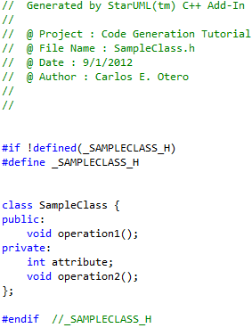
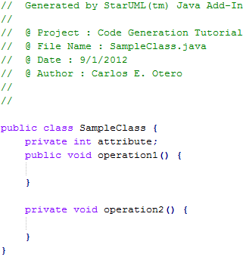
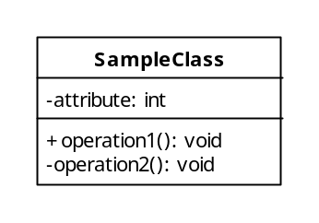
STRUCTURE MODEL (CLASS DIAGRAM)
Example of the forward engineering of a UML class to C++ and Java.
Code generated by free open source Star UML tool.
Class name
Attribute name, type, and visibility
Private and public attributes and operations
Important:
Notice how the modeled visibility {-, +} next to attribute and operations translate to code!
16

Slide 17
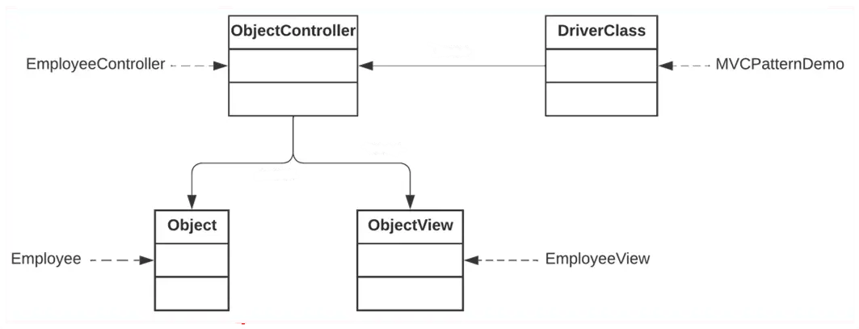
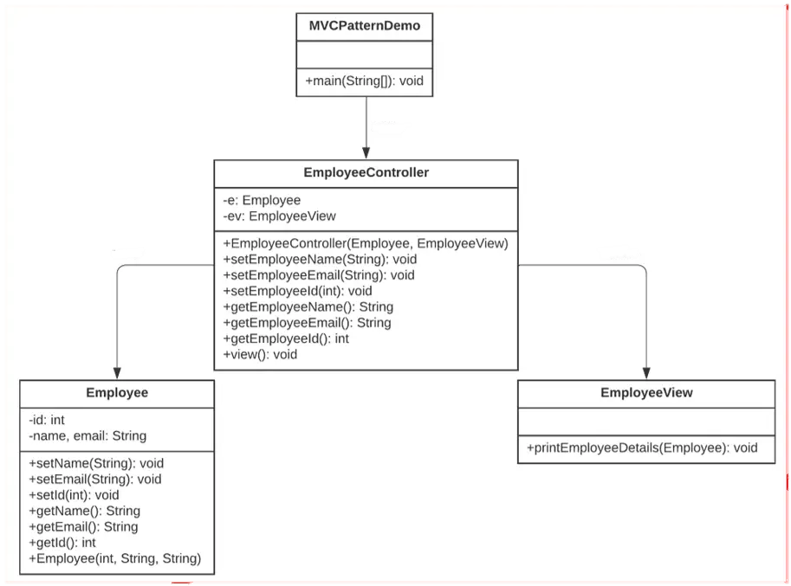
STRUCTURE MODEL (CLASS DIAGRAM)
17

Slide 18

Thank you for your participation. I am very grateful to have the opportunity into this sharing session. If there any enquiries, feels free to contact me.
+013 509 9215
khatibsyarbini@utm.my

Slide 19

THANK YOU
In the Name of God for Mankind
univteknologimalaysia
utm.my
utmofficial

